Slide 1


FRONT END DEVELOPMENT
WEEK 1 – KICK OFF !

Slide 2

KICK OFF OBJECTIVES
Kick Off
What you will be able to do at the end of this course ?
Course agenda, learning objectives, evaluation
JavaScript
What do you know so far about JS ? QUIZ + SURVEY
Write functions to convert a data to its DOM representation

Slide 3
WEB DEV CURRICULM
You already know the basic of JS syntax and DOM manipulation
We will then transition into React
You will develop skills in building components, managing state, handling events,
We will first review JavaScript and Node JS packages usages
 | TERM 1 - DESIGN | TERM 2 - FRONT | TERM 3 - BACK
W 01 | UI Design | JS Basic revisions Model To DOM | Node.js and Server
W 02 | Html | Node Modules and Packages JS ES5 | Native HTTP Server & Manual Routing
W 03 | CSS basics | Overview of React | Express Basics + POST + Middleware
W 04 | CSS Flex | JSX / Dynamic Data React Components | REST API Design + Modular Express + Axios
W 05 | CSS Grid | Props List Display | SQL with MySQL (Without ORM)
W 06 | Responsiveness + Form | Revisions | Sequelize Basics: Models & Relationships
W 07 | Web Design | Handle UI Events Use states hook | Sequelize Routes Querying
W 08 | Tailwind | Deeper on a state’s management Pass functions as value to props | Sequelize Migrations + Seeders
W 09 | JS Syntax | JS Asynchronous JS Axios - Effects | Sequelize Migrations + Seeders
W 10 | JS DOM Manipulation | Bugs tacking Revisions | Full Auth Flow (JWT + React + Sequelize)
Finally, we will learn asynchronous
And Apis data fetching
To be ready for term 3..

Slide 4
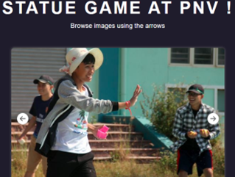
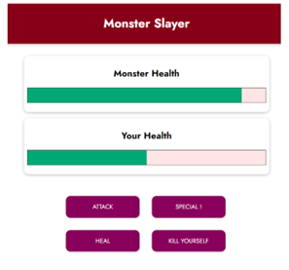
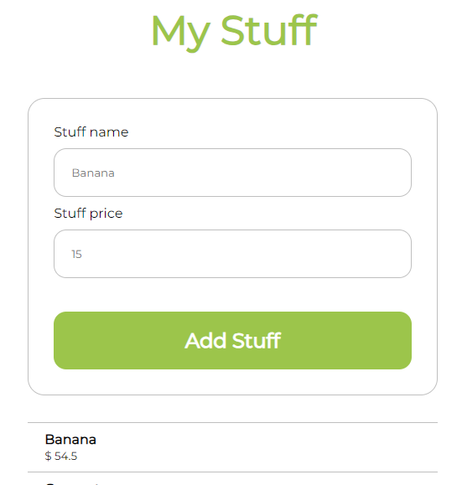
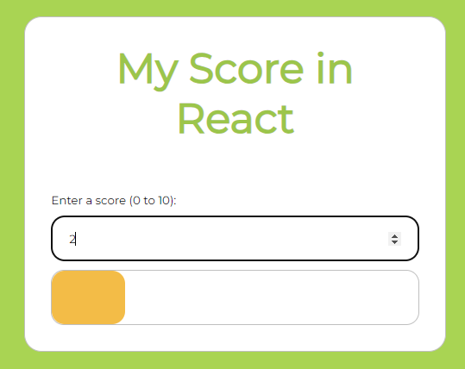
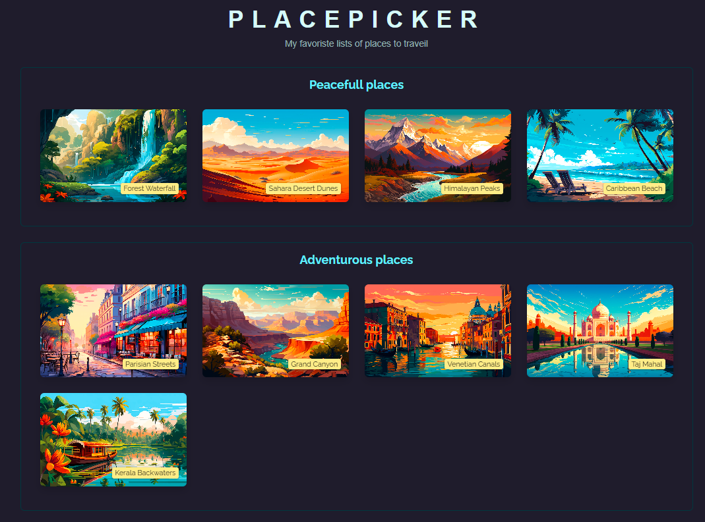
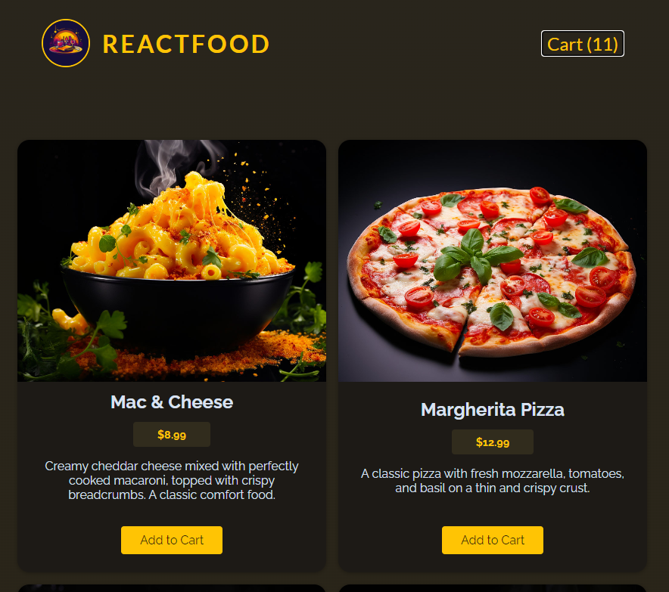
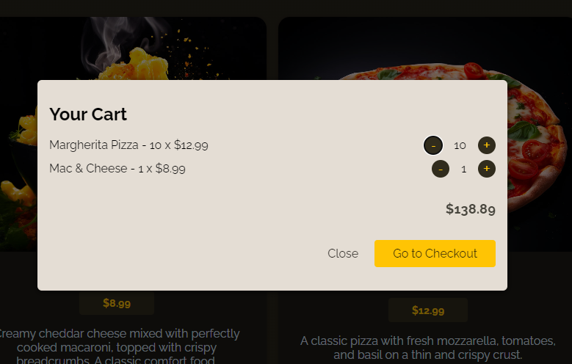
WHAT YOU WILL BE ABLE TO DO
At the end of this course
Click to try !

Slide 5
COURSE MODULES - OVERVIEW
JS Syntax
Arrays & Objects
JAVASCRIPT
DOM Tree & UI Events
Node & NPM
JSX
Components
Events
Fetching data
REACT JS
Dynamic Data
Props
States
Styling

Slide 6
 | DATE | LEARNING | EXAM / QUIZ | PROJECT
W 01 | JAN 12 | JS Basic revisions Model To DOM |  | JS QUIZ APP
W 02 | JAN 19 | Node Modules and Packages JS ES5 | JS QUIZ
W 03 | JAN 26 | Overview of React An overview of React
W 04 | FEB 02 | JSX Dynamic Data React Components
W 05 | FEB 09 | Props List Display | REACT QUIZ
W 06 | FEB 16 | Revisions
W 07 | FEB 23 | Handle UI Events Use states hook | MID TERM
W 08 | MAR 02 | Going deeper on a state’s management React lifecycle Pass functions as value to props |  | PROPOSAL
W 09 | MAR 09 | JS Asynchronous JS Axios
W 10 | MAR 16 | Bugs tacking Revisions
 | MAR 23 |  | FINAL
 | MAR 30 |  |  | JURY
COURSE AGENDA

Slide 7
TYPE OF EVALUATION | RATIO
Attendance & Participation | 10 %
Quizzes | 10 %
Mid Term | 20 %
Final Exam | 40 %
Project | 20 %
COURSE EVALUATION

Slide 8
COURSE PROJECT
As part of this course, you will undertake a project in pair
1
2
Define your website proposal
Present how you plan to develop this app within the next 4 weeks.
Project Jury
WEEK 8
WEEK 12

Slide 9

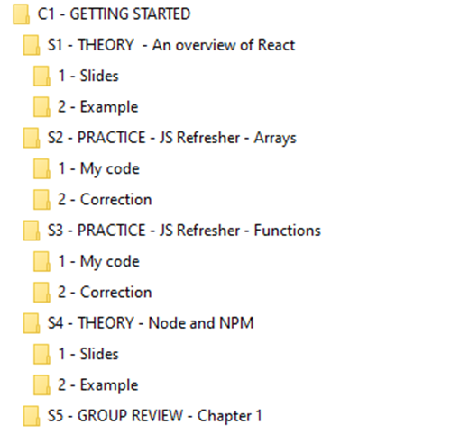
TOOLS
Organize your data !
Structure your course into folders
Level 1
Chapters
Level 2
Sessions
Your code
The teacher code
Level 3
Teacher slides
Examples viewed in class

Slide 10




TOOLS
VS Code extensions
Tools to install to work efficiently

Slide 11

RESSOURCES FOR THIS COURSE
JAVASCRIPT
https://cstart.mines.edu/web/Day2/2-JavaScriptBasicSyntax.pdf
https://www.integral-domain.org/lwilliams/mis462/JavaScript.pdf
https://www.gurukultti.org/admin/notice/javascript.pdf
https://www.w3schools.com/js/default.asp
WEBSITES
W3Scholl documentation
React official documentation
REACT
You tube channel about react JS
Udemy React Course (not free)

